Slide 1

Enviro-savers Services

Slide 2
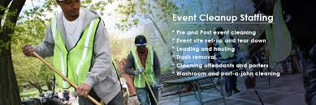
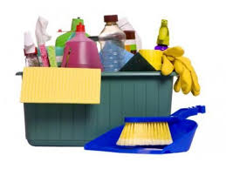
What is enviro-savers services
It is a business that promote environmental sustainability and improving lives of people. According to Millenium Development Goals, we are based more in goal number 7- to ensure the environmental sustainability to reduce biodiversity loss and also improve the live of peoples. We will also touch MDG number one to eradicate extreme hunger and poverty.

Slide 3

What do we do?
Enviro-savers offer event cleaning services for a wide range of indoor and outdoor events. Our cleaning services range from house parties, weddings, cooperate events, sporting events and a wide range of other activities request quote which require cleaning. Our events cleaning service can be done before or after the event.

Slide 4
Objectives
To minimise waste
To protect natural resources
To create job opportunities
To save money and time
To ensure environment remain sustainable
To reduce pollution

Slide 5
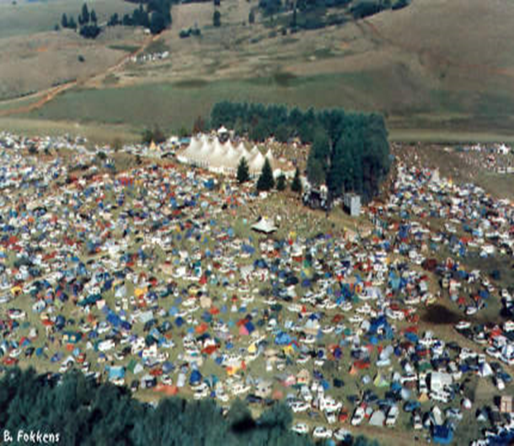
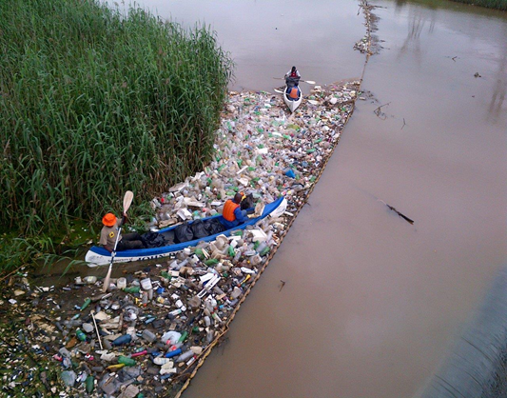
Water Pollution
Research has found out that in most cases pollution of the water is caused by events that took place around that area. Enviro-savers are the solution to minimise waste that pollutes the ocean and rivers. Having access o safe drinking water is one of the MDG’s goal under ensuring of environmental sustainability.

Slide 6
Why use Enviro-savers for your events cleaning requirements:
Our staff are well trained to conduct themselves professionally in all working environments
We have been trained to work with the number of high profiled venues for sensitive clients.
We clean beyond our clients expectations
We plan to create long lasting relations with our clients mainly in the events management’s services through our excellent service
We’re always on site to monitor the progress in a manner that is not destructive to your event.

Slide 7
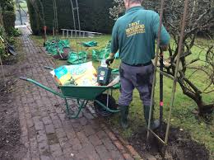
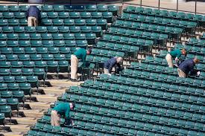
Pre Event Cleaning
Our Pre event cleaning services caters for all function venues and types. We offer cleaning before the function to your expectations and our team always ensures to have a spic and span venue ready for the function.

Slide 8
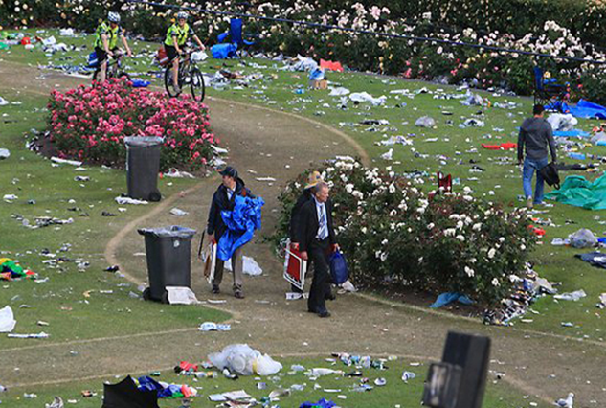
Post Event Cleaning
Our team will clean after the event is over. Post event cleaning can also be arranged so that we have our teams on standby for cleaning during the event this depends on the type of event. Our staff are professionals and are well trained to conduct themselves well. Each team has a supervisor and team leader who is responsible for the conduct of the team members and ensuring that cleaning is done up to the required company standards.

Slide 9
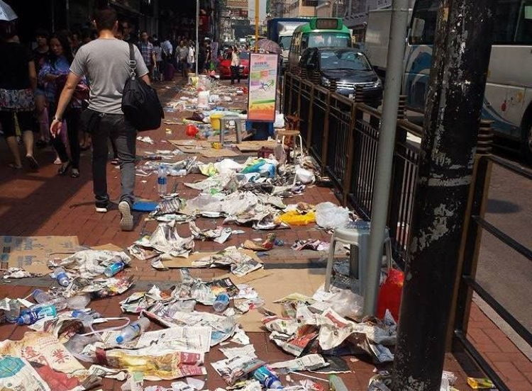
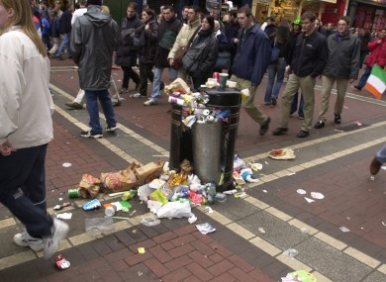
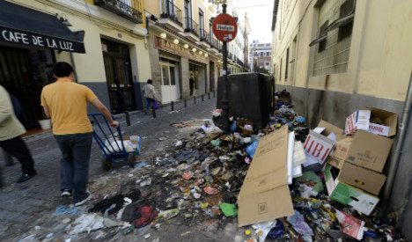
Post Event Cleaning

Slide 10
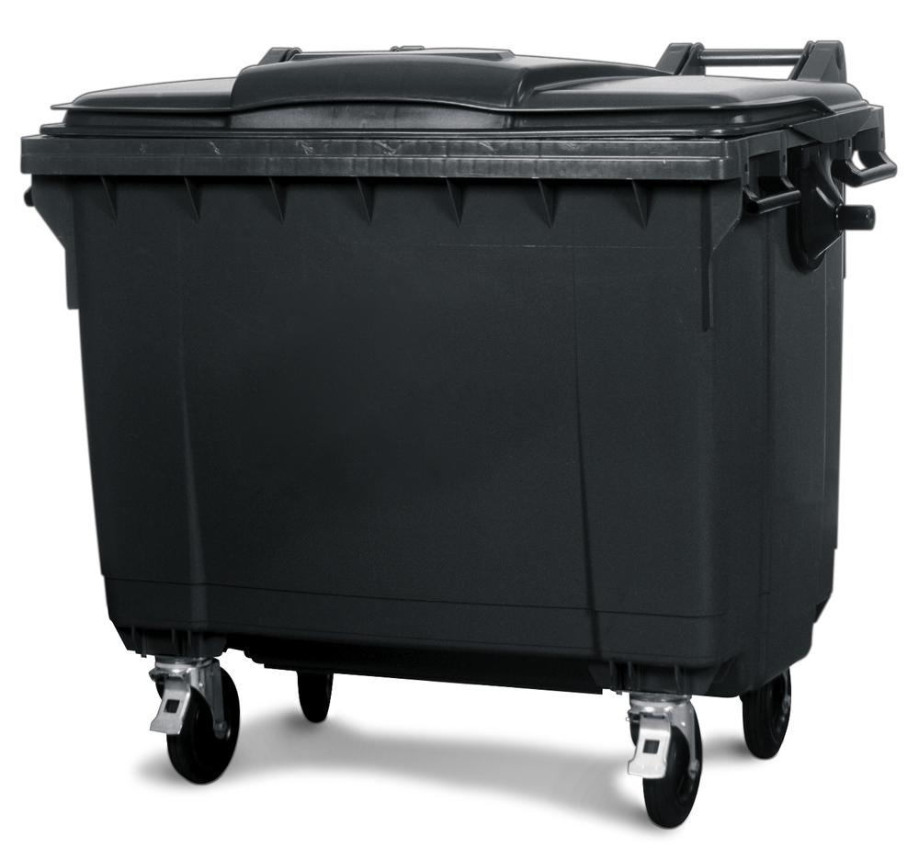
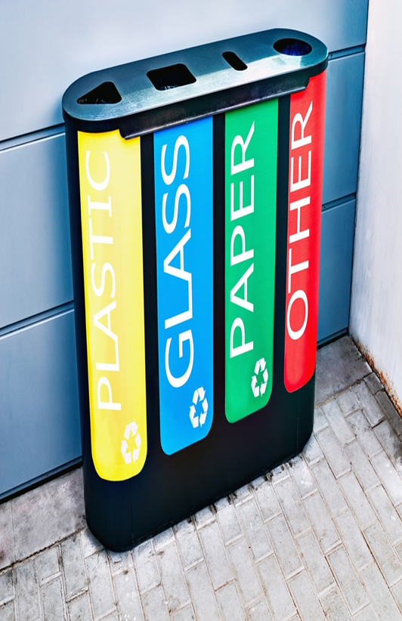
Opportunities
The waste collected is stored according to it composition like plastics, metal and paper for recycling companies where we generate some of our revenue
There is time saved by companies because they don’t go to the mine and mine a metal but they re-uses the recycled metal.
Loss to environmental resources is being reversed which is one of the requirement from the MDG’s

Slide 11
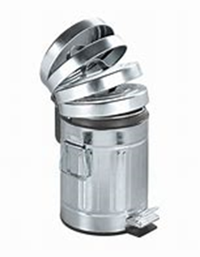
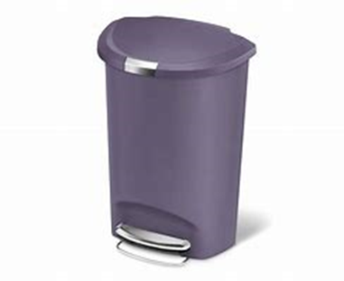
About the bins
By using this bins, it will be easy to identify them
Put up stickers and poster that shows where to litter in
We will locate them in accessible areas
We will use bins that Is more environmental friendly and attractive to the public with the latest designs

Slide 12


Equipment used
Tools that we use are environmentally friendly.
Less hazards to people and equipment that is being cleaned.
Detergents used are harmless to people, the environment and less odour

Slide 13

Conclusion
Prevention is better than cure, so saving the environment from sources of pollution like big events will indeed reduce environmental damage and promote green living
This sign can help a lot in event from preventing littering because what we’ve discovered is that most people they don’t know where to through their dirt and end up putting it anywhere where they think its right.

Slide 14
About us
Location – DURBAN
PROJECT TYPE- SUISTAINABLE WASTE MANAGEMENT AND RECYCLE
FUNDINGS-EThekwini Municipality
Email-enviro-saver@gmail.com
Telephone Number- 031 224 6572

